Slide 1


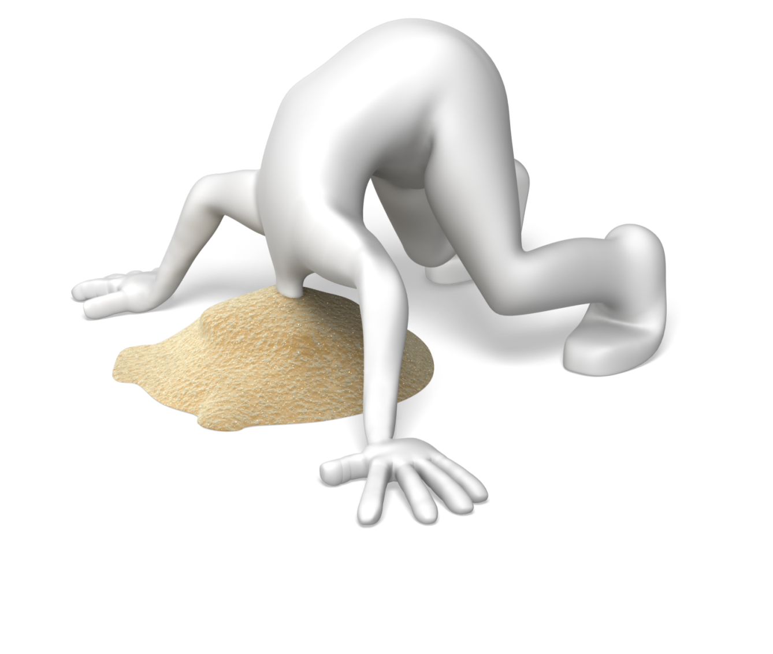
Risk Management Issues: Advertising and Recruiting Overseas Team Members and School Programs into Over-Seas Medical Service Programs
What Are You Ignoring?

Slide 2

On Recruiting Volunteers
If I find them, what do they need to know?

Slide 3

On Recruiting Volunteers

Slide 4
On Recruiting Volunteers
Recruiting volunteers, for anything, seems to be getting harder. Selling the benefits of the program is your first issue & risk, because there does not seem to be a desire to volunteer anymore

Slide 5

On Recruiting Volunteers
The liability issues are simple. Be honest. The more someone knows about the job and the risks, the less likely that:
Anything will go wrong.
Or
If something does goes wrong, it will come back to you if the volunteer understood the risk
Notes:
The more a volunteer knows and understands the less likely the volunteer will get in trouble. Even if they do have a problem, most people can deal with it because you told them not to do what got them in trouble.
You can NEVER over educate.

Slide 6
On Recruiting Volunteers
People who understand the risks understand what they need to do to avoid the risks
They enter the situation with less fear and more confidence
They enjoy themselves more
They understand rather than worry

Slide 7
On Recruiting Volunteers
Information weeds out volunteers you do not want
Those that are in constant fear
Those that believe you mislead them
Notes:
Good information scares problem volunteers away. You want someone scared sitting at home in the US, not in the middle of the jungle.

Slide 8
On Recruiting Volunteers
If you are honest and the people understood the risk beforehand, they are less likely to be upset if something does go wrong.
Notes:
Besides, if you are honest in court you look good.

Slide 9

On Recruiting Volunteers
If they feel you mislead them…...

Slide 10
The Risk of Improper Advertising & How it Increases Risk Management Issues
What Are You Ignoring?

Slide 11

Improper Advertising
MARKETING MAKES PROMISES THAT RISK MANAGEMENT HAS TO PAY FOR©
Notes:
The effort to sell, the trip, the adventure, the work is where promises are made to come back to haunt you.

Slide 12
Improper Advertising
Lawsuits in the volunteer world always start this way:
“They never told me..…
“I never knew….!”
“If I knew…..!”
Notes:
I never knew we would be 100 miles from help.
If I would have known I never would have gone.
I thought those things only occurred on TV.
One of the first cases I was involved in an intern laid at the bottom of a mountain in Nepal for hours believing that flight for life would come. Only after waiting that long did he realize that the donkey the locals had found was his ride for life.

Slide 13
Improper Advertising…
“Improper advertising” Will be the 1st & last thing used to make you look bad at trial
Notes:
Advertising, marketing, promises are easy to put into evidence. The jury gets to see them in the jury room, to hold them and to see the “lies” the plaintiff said you told.
You should either counter that will what was actually said and what you had given them or was on the website of what the real risks were.

Slide 14
The Use of Various Legal Forms to Help Control That Risk
What Are You Ignoring?

Slide 15

Legal Forms to Help Control the Risk
3 forms are needed:
Website or Written Communications
Release
Emergency Plan
Notes:
Of the 3 the release is the strongest and best defense in 45 states.

Slide 16
The one Legal Forms to Remember?
RELEASE
RELEASE
RELEASE RELEASE RELEASE
RELEASE
RELEASE
RELEASE
RELEASE
RELEASE
RELEASE
RELEASE
RELEASE
RELEASE
RELEASE
RELEASE
RELEASE
RELEASE
RELEASE
RELEASE
Notes:
Do not be afraid to show the worst. It will scare away the people who should not go. If they can’t deal with it online how are the going to deal with it in real life.
Besides it will encourage some volunteers.

Slide 17
Do I need to Reinforce this?
RELEASE
RELEASE
RELEASE RELEASE RELEASE
RELEASE
RELEASE
RELEASE
RELEASE
RELEASE
RELEASE
RELEASE
RELEASE
RELEASE
RELEASE
RELEASE
RELEASE
RELEASE
RELEASE
RELEASE
Notes:
Do not be afraid to show the worst. It will scare away the people who should not go. If they can’t deal with it online how are the going to deal with it in real life.
Besides it will encourage some volunteers.

Slide 18
Legal Forms to Help Control the Risk
A website or information that lays out all the risks
The Good
The Bad
The Ugly &
The Really Bad & Ugly!
Notes:
Do not be afraid to show the worst. It will scare away the people who should not go. If they can’t deal with it online how are the going to deal with it in real life.
Besides it will encourage some volunteers.

Slide 19
Legal Forms to Help Control the Risk
A release which incorporates the risk issues, properly written (by an attorney) who understands what you are trying to accomplish and what a release is
Notes:
If written correctly, if it points out the general risks, if it does not mis inform, if it is written in large type and the person is given plenty of time to read it, the release stops lawsuits quickly.

Slide 20
Legal Forms to Help Control the Risk
If you got your Law Degree from the same place I got my medical degree……You don’t write releases & I’ll only prescribe bourbon!

Slide 21
Legal Forms to Help Control the Risk
An emergency plan that not based on paper but based on what can go wrong & what can be done (not a hypothetical we should….)
Notes:
What resources do we have?
What skills do we have?
What can we do, and still survive ourselves.

Slide 22
Legal Forms to Help Control the Risk
The first thing opposing attorneys look at now days are emergency plans

Slide 23
Legal Forms to Help Control the Risk
Danger 2
Danger 1
Too many of them are written without a real understanding of how it will be implemented or will work.
All of them put expectations and requirements on people with little experience, no training or who panic
Notes:
Your plan does not work if the people you have cannot implement. It might be a best seller but if no one can follow it, remember it, or do it, it is a worthless piece of paper better used to start a fire for the victim.

Slide 24
Emergency Plan
If you plan is longer than one page, you are writing too much and thinking to hard
Notes:
A plan is a course of reacting, not a script

Slide 25

Legal Forms to Help Control the Risk
Besides, NO ONE can remember page 2 of an emergency plan in an Emergency!

Slide 26
Legal Forms to Help Control the Risk
You need to do something, not read a book!
Notes:
What happens if you have a well thought out plan, which does not get followed? You will be explaining both why your plan was bad and why it was not followed.
What if you plan had 30 possible scenarios. How are going to explain that the thing that did happen was not covered in your plan.
You plan should look at resources, who can help, how long till help arrives and not much more. It does not matter if it is a fire, flood, volcanic eruption or whatever the disaster, the issue is, what can you do with the resources and people you have.

Slide 27
You can’t plan for Everything so why try?
What Are You Ignoring?

Slide 28
In Remote Areas you have ONE issue:
Evacuation

Slide 29
Legal Forms to Help Control the Risk
Evacuation
How
How Long
How Much
Notes:
How Much?
No evacuation by the Army was possible in Argentina on Aconcagua
Unless you had $1000 (or more) in fresh clean $100 bills
We all used to carry $500, straight from the bank for emergencies.
(99% of the time the emergency was a bad credit card in a bar in Mondoza….)

Slide 30
What Risk Management Issues Should Be in Place to Minimize Leadership & Organizational Exposure
Due Diligence

Slide 31
Due Diligence
You must have been to the area in advance and done your due diligence

Slide 32
Due Diligence
Or the location is not so third world that Americans would feel out of place all the time
Notes:
If there are other American’s there, then you don’t need to worry about due diligence. If it is a tourist stop. If customs smiles when you arrive because they now the city is going to get money.

Slide 33
Due Diligence
Checking the area for and understanding the risks
Notes:
What is Due diligence?

Slide 34
Due Diligence
If you can’t then you need to ONLY recruit volunteers who have experience in going places they have not gone before
Notes:
If you cannot due, due diligence, then you are severely restricting your volunteer pool to people who like or have popped into third world Impoverished countries before and can survive. Suggests. Conrad Anker,, etc.

Slide 35
Due Diligence
You can’t take people places unless you can say I know the risks
Notes:
Or they already know the risks

Slide 36
Due Diligence
Means you have explored, checked out and know the place you are going

Slide 37
Due Diligence
Examples of what due diligence might mean

Slide 38
Due Diligence
Danger 1
Danger 2
You have to have checked out all sub-contractors/
third vendors party vendors
You have informed your participants/ volunteers of the risk

Slide 39

Due Diligence
Danger 1
Danger 2
You have made your way to & from the location, & have alternative transportation options.
You have to understand local laws concerning medical care

Slide 40
Due Diligence
You have to know who can provide what medical care
Notes:
What is the law of the place you are going on who can provide medical care. You don't want to be breaking the law.

Slide 41
Due Diligence: Education
In most places, anyone can provide medical care. An EMT or nurse can perform surgeries

Slide 42
Due Diligence: Education
You need to understand what you are comfortable allowing other people to do?
Notes:
Just because anyone can do surgery does not mean everyone should do surgery.

Slide 43
Due Diligence: Education
You need to understand the taboos, fears and customs of the people you are dealing with
Notes:
Taking a picture of someone used to be taboo in a lot of places, now days it means they get money. But other issues abound.

Slide 44
Due Diligence: Education
You need to understand local laws with respect to what your volunteers might assume or not know
Notes:
Spitting on the sidewalk or street. No observing religious issues.
It is against the law to proselyte in Peru. Check out how many missionaries have been killed in Peru because they were “drug smuggler's.”
I was leading and before we left the city a guest lost his wallet at the hotel. Later that day he said that he had found his wallet & hoped the cleaning person did not get into much trouble. I immediately took off to the jail where the cleaning lady was sitting for stealing the American’s wallet.

Slide 45
Due Diligence: Education
You need to remind your volunteers that US laws stay in the US, & once you cross the border you are in a different world

Slide 46
Due Diligence: Education
Danger 1
Danger 2
Someone on your trip must be able to communicate
The farther down the scale of third-world countries the more this important
Notes:
People used to dealing with American’s think it is funny (or an insult) when we screw up their language. When you are dealing with someone who has not dealt with Americans, they may take you literally.

Slide 47
Due Diligence: Education
High school Spanish will get you snickers in Spain but could get you in trouble in Amazon jungle were a combination of Portuguese, Spanish & other languages are spoken

Slide 48
Due Diligence: Education
Danger 1
Danger 2
You have to know your help is wanted by the Local and Federal Government
You have to stay aware of the politics: What if the relationship between the US and the country you are in change

Slide 49
Due Diligence: Education
You need to notify the US embassy and/or consulate of your plans

Slide 50
Information and Education are becoming critical today to recruit volunteers, keep them happy and working and keep you both away from courtrooms

Slide 51


Keep your head out of the Sand!
Marketing Makes Promises that Risk Management Has to Pay For
Educated & Informed
Understand the Risk
Legal Forms
Due Diligence

Slide 52
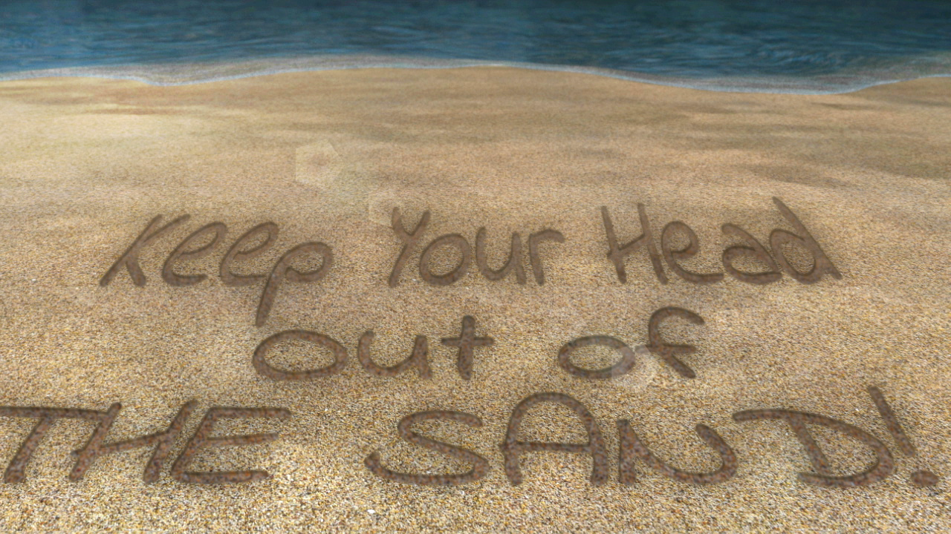
James H. (Jim) Moss, JD
www.recreation-law.com

